Slide 1
Report
On CLIP
Speaker: YANG Renwei
Department of Computer Science,
City University of Hong Kong

Slide 2
CONTENT
01
02
03
Significance
of CLIP
CLIP
Main Idea
Encoder
Details
Notes:
You’ll know the reason in part 1, the significance of CLIP.

Slide 3
PART 1
Significance

Slide 4
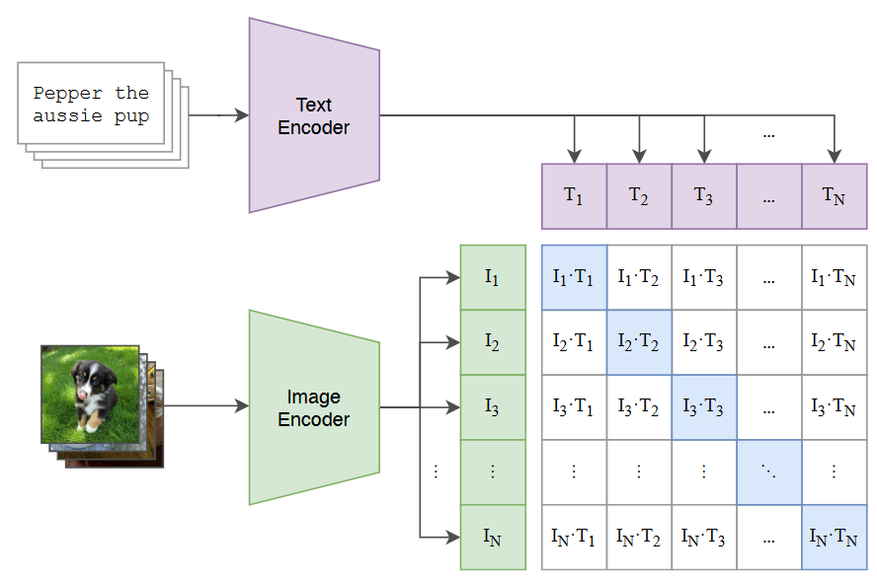
Significance
PART 1
1. Bridge between image and text
A. Radford et al., “Learning Transferable Visual Models From Natural Language Supervision,” in Proceedings of the International Conference on Machine Learning, Feb. 2021, pp. 8748--8763.
Notes:
CLIP take both text and image as input，and their features meet each other in CLIP

Slide 5
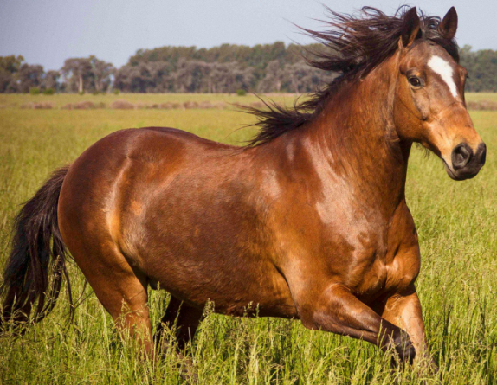

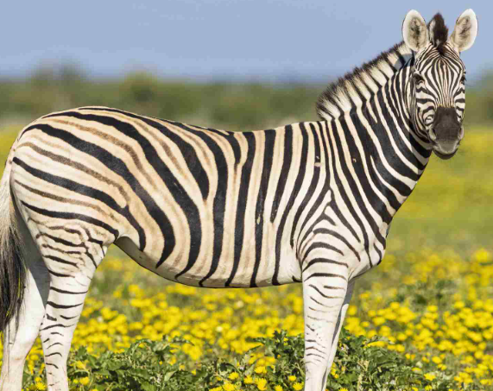
Significance
PART 1
2. Zero-shot classification
+
Learned
Learned
Unlearned
Notes:
CLIP can classify object which is never learned， as long as you give appropriate description.
Now you see why is it helpful to your job. Suppose you are developing a traditional classifier in a company，

Slide 6
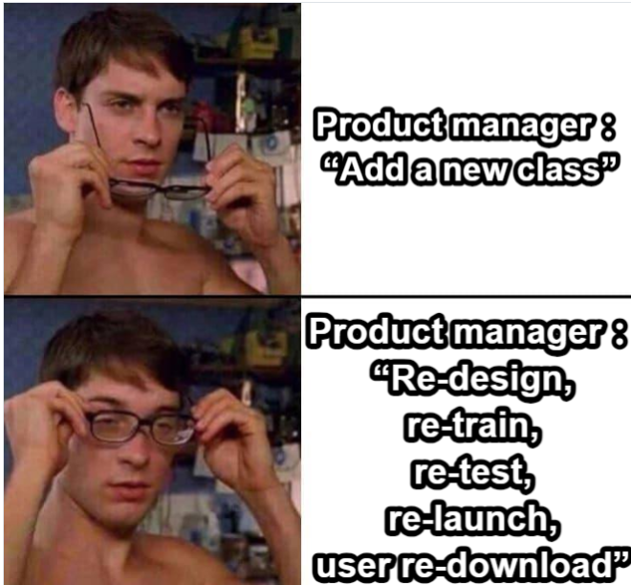

PART 1
Notes:
And one day your product manager says, hey, add a new class to your model. He may think its easy, but actually not, especially when the model is already on the users‘s devices. It will take a lot of work, to the whole things again.
But now, we have CLIP. You can just type a sentence, and then, the work is done. Amazingly convenient.
So how does clip achieve these things？ Let’s check out in part2.

Slide 7
PART 2
CLIP Main Idea

Slide 8
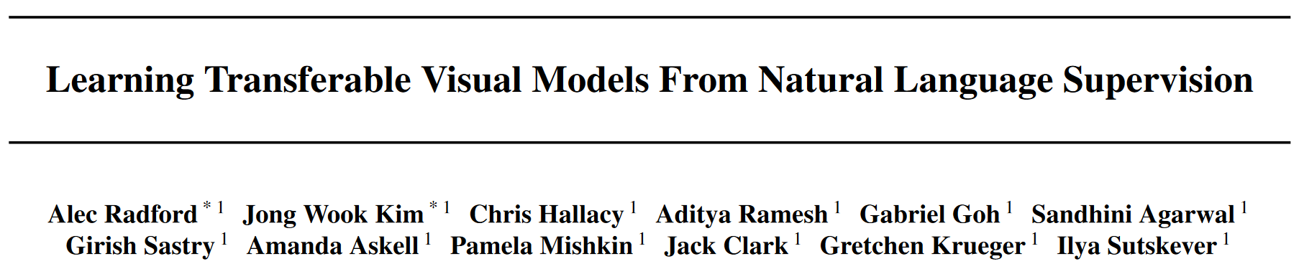
Part2 CLIP Main Idea
Supervised by Natural Language
A. Radford et al., “Learning Transferable Visual Models From Natural Language Supervision,” in Proceedings of the International Conference on Machine Learning, Feb. 2021, pp. 8748--8763.
Notes:
CLIP is proposed in this paper by OpenAI. I believe you are very familiar with this company，especially when doing homework.
frist of all, let’s see its title. The key is that ,it is superveid by Natural language. recall that in the past, a classifier model is usually supervised by a one-hot vector，for example resnet.

Slide 9
Part2 CLIP Main Idea
CLIP
=
Contrastive Language-Image Pre-training
Notes:
contrastive , it learns from the data itself, so it is free of human-annotation. one benefit is that the dataset is easier to be very large.

Slide 10
Part2 CLIP Main Idea
A. Radford et al., “Learning Transferable Visual Models From Natural Language Supervision,” in Proceedings of the International Conference on Machine Learning, Feb. 2021, pp. 8748--8763.
Notes:
Here’s the training diagram：We have a batch of image / text samples, they are encoded into feature vectors. e.g. I1 T1 stands for…
Then, we calculate the inner product for each pair. Recall that only when they have the same index, they are the positive sample，other = negative

Slide 11
Part2 CLIP Main Idea
Notes:
capital I, lower I, Suppose each feature vector has m dimension, then it can be expressed as …
In the feature space, the input image have already been transformed into this matrix, this is also the same for the text matrix.
So in the result matrix, each element is the inner product of an image and a text. And this can be interpreted as the similarity

Slide 12
Part2 CLIP Main Idea
Ideally..
Identity matrix
Notes:
Ideally，the result should be an identity matrix. because diagonal is the pair…
Of course that is just the idea scenario. So In CLIP, how do we get close to this ideal scenario?
It’s simple. We just train the text/image encoders. Note that they are both deep learning based encoders, so they can learn how to make the matched pairs close to each other. In other words , to make the inner product bigger
In the paper, they use vit and resnet as the image encoder, and use BERT as the text encoder. We will talk about it in part 3 later.

Slide 13
Part2 CLIP Main Idea
Notes:
After encdoers, let’s see how the loss is calculated.
You may haved noticed that, for each column / each row, there is only 1 matched pair. Meanwhile, note that CLIP uses contrastive learning.
So there is only 1 positive sample in each column / each row, that is the matched pari. This value should be 1. And others values, should be 0.
It sound familiar, right.
For traditional model, its output is the one-hot vector. This is very similar to the situation here, for a single column or a single row. So CLIP, also uses same function to calculate the loss.

Slide 14
Part2 CLIP Main Idea
Cross Entropy Loss
Notes:
It uses cross entropy loss. In this function, p(x) is the identity matrix，q(x) is the actual output matrix.
To draw a conclusion, the training purpose is to push the similarity of same pair to be 1, and other pairs to be 0.

Slide 15
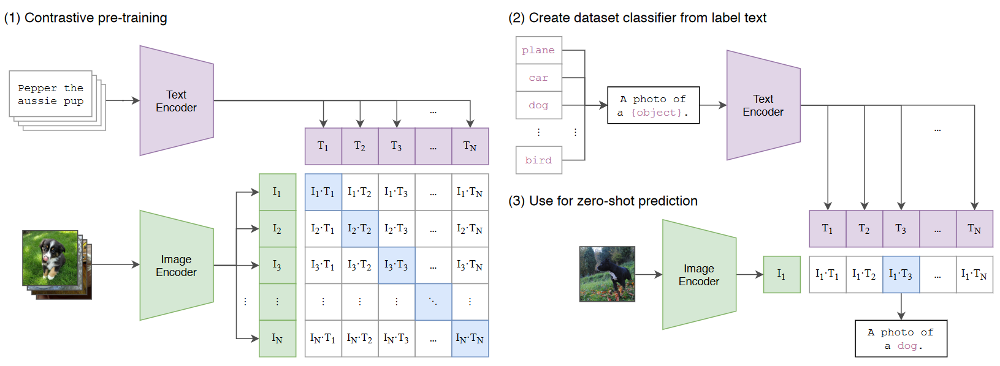
Part2 CLIP Main Idea
Notes:
So, this is the training stage, the left part of this figure. What about the inference stage? How to do classification using CLIP? It is very interesting. CLIP does not output a class name. Instead, it needs sentences.

Slide 16
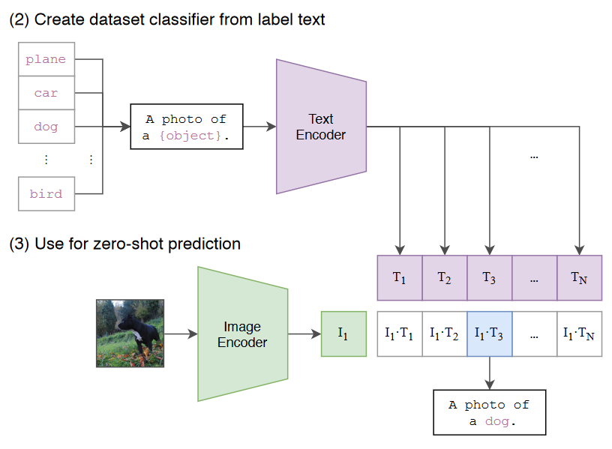
Part2 CLIP Main Idea
1.Put the label in a sentence
2.Prompt engineering
3.Zero-shot
Notes:
We do a tricky thing here: We put the class names in the brackets to form a sentence. Then we compare the similarity between the image to each sentence, and the highest one is the result. We do this, because CLIP is trained like this. Note that the training dataset. from internet, just normal sentence in daily life. Therefore, we should use sentence like that
A more tricky thing: HINT. you can give some HINT in the sentence. like, you can remind CLIP that this is a kind of animal. And then, your warm reminder, can indeed increase the accuracy of CLIP. This kind of trick has already become a Research topic: prompt engineering. the purpose of prompt is to reduce uncertainty. Uncertainty is common in human language.

Slide 17
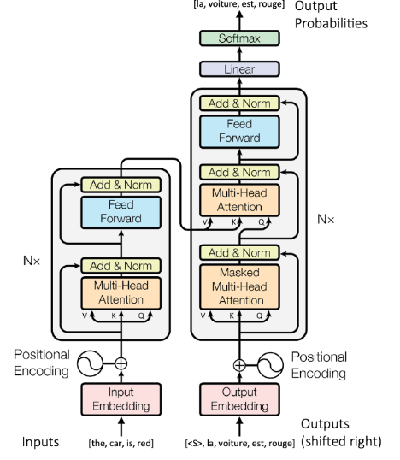
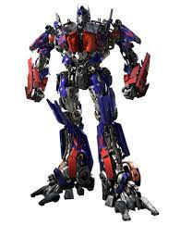
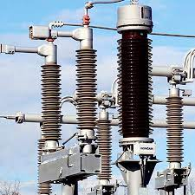
2.Prompt engineering
Part2 CLIP Main Idea
Transformer = ?
Notes:
e.g. the word “transformer”, it doesn’t know which transformer does it mean. deep model, voltage transformer, or those giant robotics?
In this case, prompt can give an appropriate context to CLIP. Such that the confusion is reduced.
You see, CLIP is just like real human being, it can understand the natural sentences. Based on that, it has a more interesting function: zero-shot. zero-shot means that, CLIP can correctly classify an object that is never learned before, as long as you give the appropriate name 。 For example,

Slide 18
Part2 CLIP Main Idea
3.Zero-shot
+
Horse
Learned
Pedestrian crossing
Learned
A horse with skin like pedestrian crossing
Unlearned, but recognizable
Notes:
zero-shot means that, CLIP can correctly classify an object that is never learned before, as long as you give the description of the object.
Here’s an example. We want to classify a zebra, but CLIP has never learned it before. How can we solve it?
Since the word ‘Zebra’ has not been learnt, we do not use it as the class name. Instead, we give description of zebra, and use the description as the class name. Further more, the description should be based on the words that have been learned. Suppose CLIP has learned horse, and has learned pedestrian crossing, so we can form a description like: … Then this long description is the class name.

Slide 19

Part2 CLIP Main Idea
3.Zero-shot
A horse with skin like pedestrian crossing
Notes:
We put it in that sentence. And then, the problem is solved. CLIP can correctly classify this image now.
This is quite an amazing feature of CLIP. This is based on 2 fundamental reasons. 1st, as the paper title states, CLIP is supervised by Natural Language. In other words, the image and text features meet each other in the model. 2nd reason, is the large training dataset. It contains 400,000,000 pairs of image and text. This is what OpenAI can do.

Slide 20
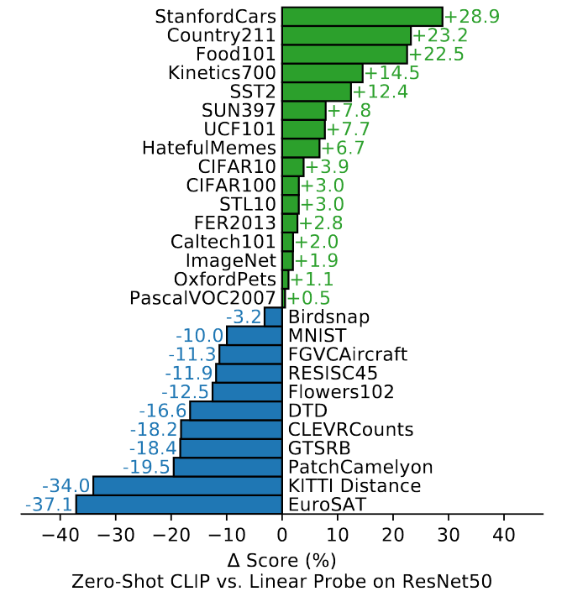
Part2 CLIP Main Idea
A. Radford et al., “Learning Transferable Visual Models From Natural Language Supervision,” in Proceedings of the International Conference on Machine Learning, Feb. 2021, pp. 8748--8763.
Notes:
Let’s see a performance comparison. Here’s 27 datasets The green line means that CLIP … and blue line means that … It should be noted that resnet is trained on each dataset, but CLIP is zero-shot. In this case, CLIP can output in many cases.

Slide 21
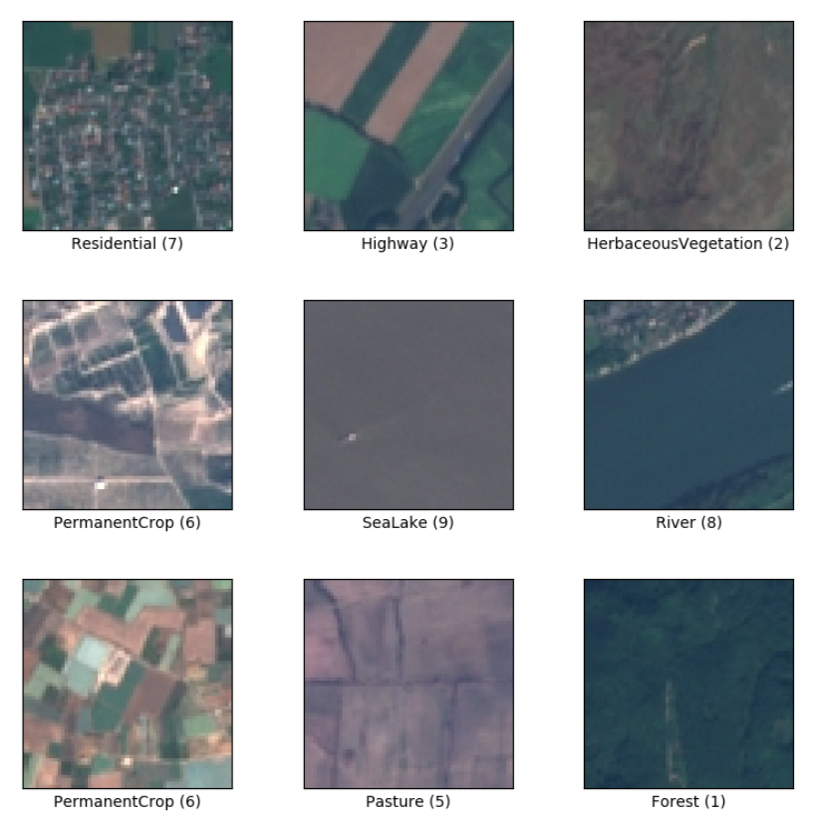

Part2 CLIP Main Idea
StanfordCars
EuroSAT
Notes:
it comes as no surprise. left is common on the internet, but EuroSAT are the satellite photos ，they rarely appear on the web., so they rarely appear on the trainingset of CLIP.

Slide 22
Part2 CLIP Main Idea
Other applications:
· Text-image search
· Event detection
· DALL-E
···
Notes:
Besides classification, CLIP can do more things.
give a description, returns the Best Matching Image
or for a video, which frame, CLIP search it for you
or another OPEN AI product, DALLE, it is for text-image generation, it is developed based on CLIP

Slide 23
PART 3
Encoder Details

Slide 24
Part3 Encoder Details
A. Radford et al., “Learning Transferable Visual Models From Natural Language Supervision,” in Proceedings of the International Conference on Machine Learning, Feb. 2021, pp. 8748--8763.
Notes:
In part 3，we focus on the encoders. Recall that CLIP training diagram is like this,

Slide 25
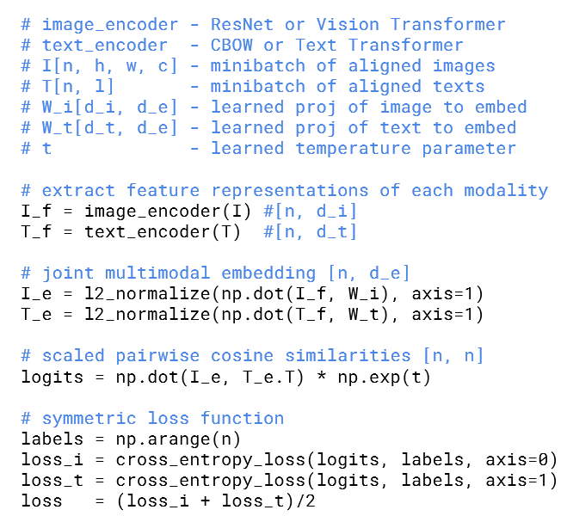
Part3 Encoder Details
Notes:
here is the pseudo code, let’s see how it works.
First of all, in the red box, we define some modules.
im encoder could be … Text encoder could be… In this paper CLIP = resnet+vit, text transformer。 In fact in this paper，
Wi and Wt are the projection matrix. When image and text are encoded, they are projected to embed using Wi and Wt , and then they can do the inner product to calculate the similarity. In the actual code, they are fully connected layers. Note that these matrices are learnable.
and next , the temperature parameter t. This is used adjust the scale of inner product result. It could be a hyper parameters，but doing cross validation on CLIP is too expensive, so the author sets it as learnable

Slide 26
Part3 Encoder Details
Notes:
image and text are encoded to obtain features. they have different number of dimensions, di and dt.
They are then projected using matrix Wi Wt. In actual code, this step is realized through the full connected layer. Followed by that, we do a L2 normalization. Please note that, now the image and text features are aligned，they both have dimension number de
Then, matrix Ie is multiplied by the transpose of Te, and further multiplied by the exponential of t. Now we have the inner product result, called logits. This matrix contains the similarity of each pair.

Slide 27
Part3 Encoder Details
Notes:
Eventually, the loss can be calculated using the cross entropy loss function. As you can see, we calculate both the image and the text. They are actually based on the same logits matrix, but in the different direction. For image, there are N images in a minibatch, the output of each sample is in the horizontal direction, so the loss is calculated using each row. For text, it is using the columns.
So, what does the magic encoder look like?

Slide 28
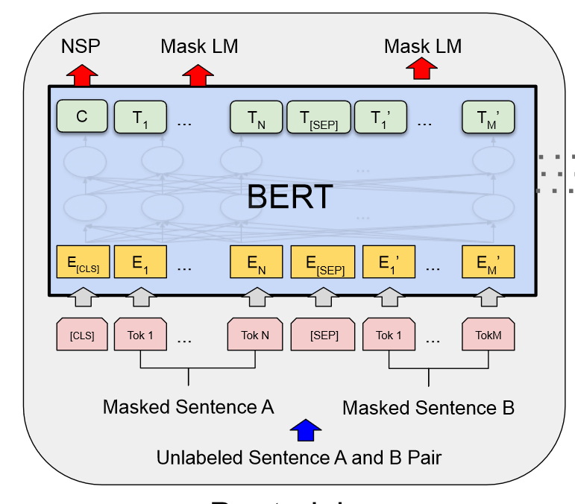
Part3 Encoder Details
J. Devlin, M.-W. Chang, K. Lee, and K. Toutanova, “BERT: Pre-training of Deep Bidirectional Transformers for Language Understanding,” presented at the naacL-HLT, May 2019.
Notes:
Here is a diagram of BERT. In the input document, each sentence is tokenized into many tokens,like the Tok 1~N, Tok 1~M. Between sentences, there is a Seperation. At the beginning of the document, there is a classification token. These tokens are embedded into high-dimension vectors,

Slide 29
Part3 Encoder Details
Self attention layer
Feed forward layer
Normalization layer
J. Devlin, M.-W. Chang, K. Lee, and K. Toutanova, “BERT: Pre-training of Deep Bidirectional Transformers for Language Understanding,” presented at the NAACL-HLT, May 2019.
Notes:
then they will pass through some …. ff is… norm is… they are very straightforward.

Slide 30
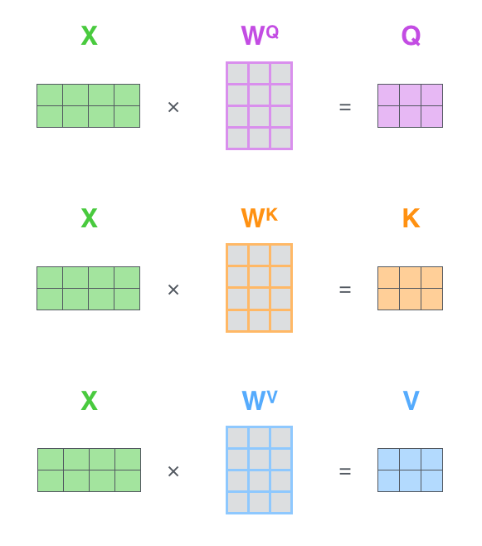
Part3 Encoder Details
Notes:
suppose there is an input x, the x represents a sentence, each row of x is the embedded token. x is multiplied by these 3 matrices to obtain QKV matrices，indicating the query，key and value

Slide 31
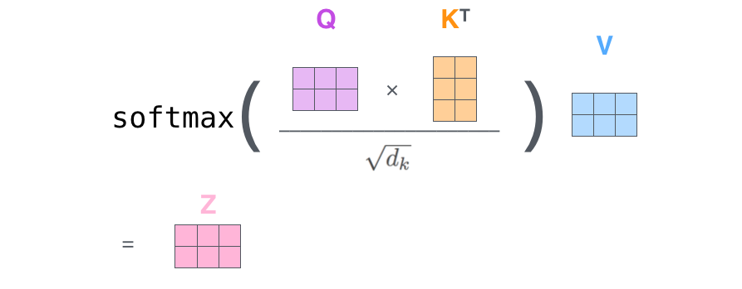
Part3 Encoder Details
Notes:
Q multiplied by K transpose，divided by a factor，softmax, and we have the attention matrix. It is multiplied by v to obtain z, z is the result of self attention. recall that each row of x = embedded token, each row of z can be interpreted as the weighted sum of the whole sentence in the feature space.

Slide 32
Part3 Encoder Details
J. Devlin, M.-W. Chang, K. Lee, and K. Toutanova, “BERT: Pre-training of Deep Bidirectional Transformers for Language Understanding,” presented at the naacL-HLT, May 2019.
Notes:
Let’s look back to the BERT model。now we know that at each token position，there will be a feature vector output. But in the CLIP model, only the first feature vector is needed, which is the output of classification token.
The reason is, during the pre-training of BERT, only the 1st feature vector is used for classification. So it contains the most informative features of the sentence.
This is for the text encoder , here is the image encoder

Slide 33
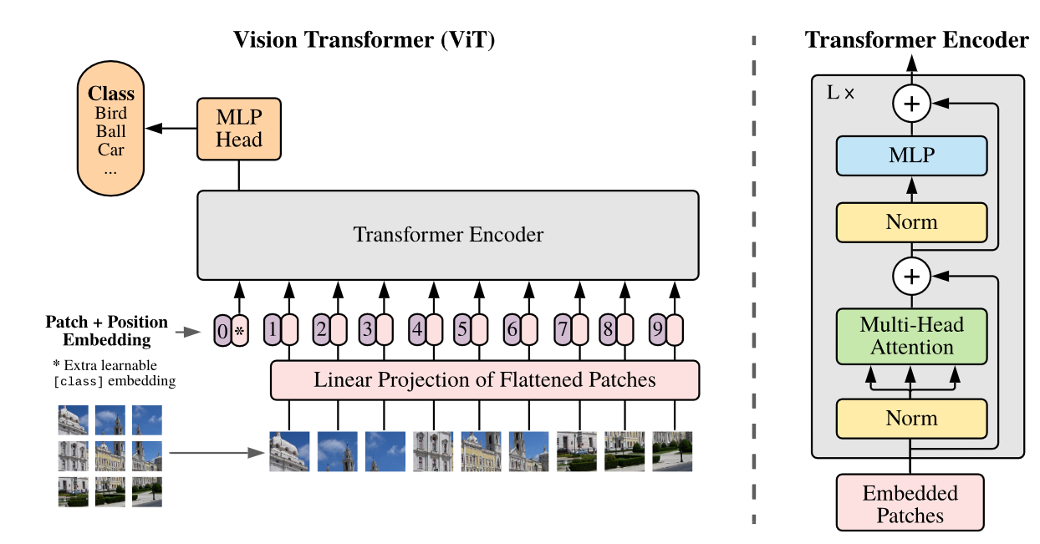
Part3 Encoder Details
A. Dosovitskiy et al., “An Image is Worth 16x16 Words: Transformers for Image Recognition at Scale.” arXiv, Jun. 03, 2021.
Notes:
vision transformer, also called ViT. It's actually very similar to BERT. We just need to replace sentences with images, and replace words with small images patches, and the other things are basically the same

Slide 34
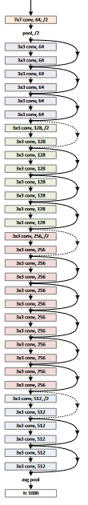
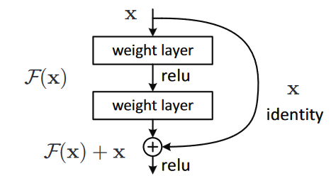
Part3 Encoder Details
K. He, X. Zhang, S. Ren, and J. Sun, “Deep residual learning for image recognition,” in Proc. IEEE Conf. Comput. Vis. Pattern Recognit. (CVPR), 2016, pp. 770–778
Notes:
another image encoder, is the very classical network resnet. The CLIP model uses the output after average pooling layer, which is 1 layer before the end of the resnet.

Slide 35
Review
01
02
03
Significance
of CLIP
CLIP
Main Idea
Encoder
Details
Notes:
in this pre, we first show the significance of CLIP: it connects image and text, and it is zero-shot; then in part2, we have discussed the main idea CLIP; finally in part 3, we dive into details of this model.

Slide 36
END
THANK YOU
Speaker: YANG Renwei
City University of Hong Kong

